Slide 1
10
JavaScript: Arrays

Slide 2
10.1 Introduction
10.2 Arrays
10.3 Declaring and Allocating Arrays
10.4 Examples Using Arrays
10.5 Random Image Generator Using Arrays
10.6 References and Reference Parameters
10.7 Passing Arrays to Functions
10.8 Sorting Arrays
10.9 Searching Arrays: Linear Search and Binary Search
10.10 Multidimensional Arrays
10.11 Building an Online Quiz
10.12 Wrap-Up
10.13 Web Resources

Slide 3
10.1 Introduction
Arrays
  Data structures consisting of related data items
  Sometimes called collections of data items
JavaScript arrays
  “dynamic” entities that can change size after they are created

Slide 4
10.2 Arrays
An array is a group of memory locations
  All have the same name and normally are of the same type (although this attribute is not required in JavaScript)
Each individual location is called an element
An element may be referred to by giving the name of the array followed by index of the element in square brackets ([])

Slide 5
10.2 Arrays (Cont.)
The first element in every array is the zeroth element.
The ith element of array c is referred to as c[i-1].
Array names follow the same conventions as other identifiers
A subscripted array name
  can be used on the left side of an assignment to place a new value into an array element
  can be used on the right side of an assignment operation to use its value
Every array in JavaScript knows its own length, which it stores in its length attribute and can be found with the expression arrayname.length

Slide 6
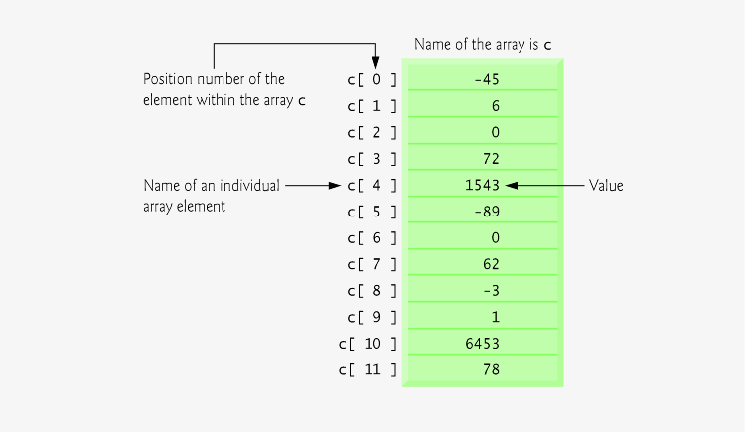
Fig. 10.1 | Array with 12 elements.

Slide 7
Common Programming Error 10.1
It is important to note the difference between the “seventh element of the array” and “array element seven.” Because array subscripts begin at 0, the seventh element of the array has a subscript of 6, while array element seven has a subscript of 7 and is actually the eighth element of the array. This confusion is a source of “off-by-one” errors.

Slide 8
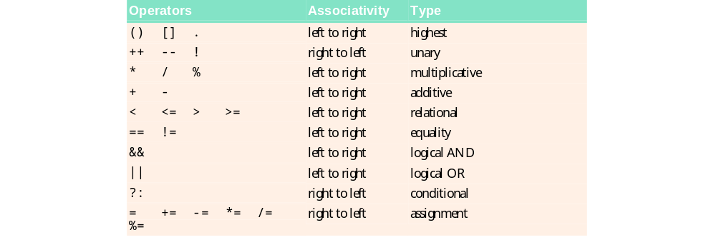
Fig. 10.2 | Precedence and associativity of the operators discussed so far.

Slide 9
10.3 Declaring and Allocating Arrays
JavaScript arrays are Array objects.
Creating new objects using the new operator is known as creating an instance or instantiating an object
Operator new is known as the dynamic memory allocation operator

Slide 10
Common Programming Error 10.2
Assuming that the elements of an array are initialized when the array is allocated may result in logic errors.

Slide 11
10.4 Examples Using Arrays
Zero-based counting is usually used to iterate through arrays
JavaScript reallocates an Array when a value is assigned to an element that is outside the bounds of the original Array
Elements between the last element of the original Array and the new element have undefined values

Slide 12
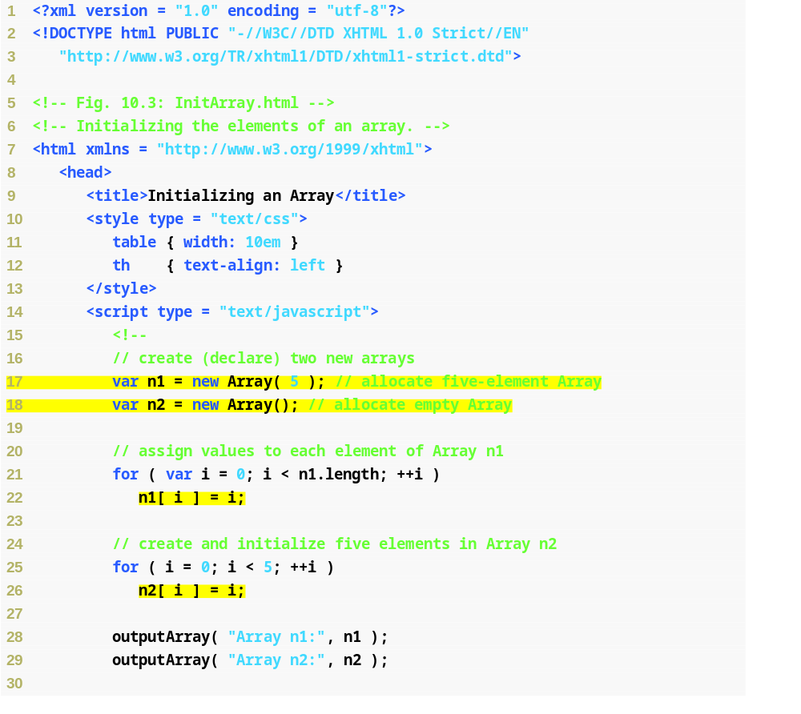
Fig. 10.3 | Initializing the elements of an array (Part 1 of 3).
Operator new allocates an Array called n1 with five elements
Operator new allocates an empty Array called n2
Zero-based counting used in for loop to set each element’s value equal to its subscript
Five elements added and initialized in n2, which dynamically expands

Slide 13
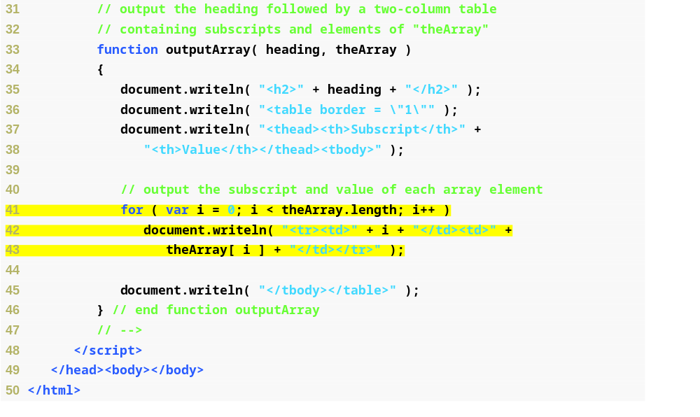
Fig. 10.3 | Initializing the elements of an array (Part 2 of 3).
Outputs the subscript and value of every array element in a table

Slide 14
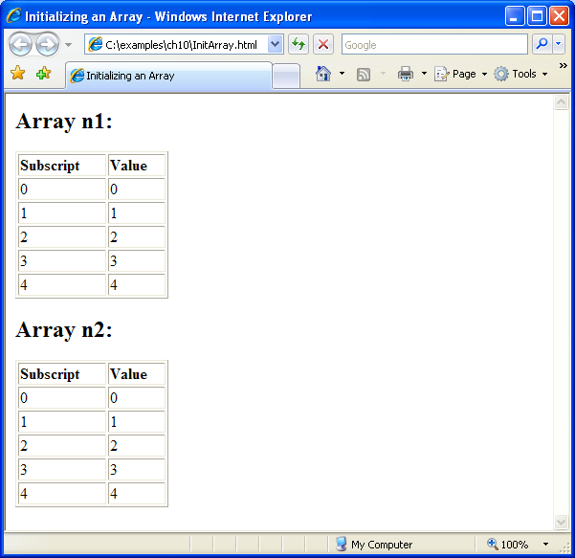
Fig. 10.3 | Initializing the elements of an array (Part 3 of 3).

Slide 15
Software Engineering Observation 10.1
JavaScript automatically reallocates an Array when a value is assigned to an element that is outside the bounds of the original Array . Elements between the last element of the original Array and the new element have undefined values.

Slide 16
Common Programming Error 10.3
Referring to an element outside the Array bounds is normally a logic error.

Slide 17
Error-Prevention Tip 10.1
When using subscripts to loop through an Array, the subscript should never go below 0 and should always be less than the number of elements in the Array (i.e., one less than the size of the Array ). Make sure that the loop-terminating condition prevents the access of elements outside this range.

Slide 18
10.4 Examples Using Arrays (Cont.)
Arrays can be created using a comma-separated initializer list enclosed in square brackets ([])
  The array’s size is determined by the number of values in the initializer list
The initial values of an array can be specified as arguments in the parentheses following new Array
  The size of the array is determined by the number of values in parentheses

Slide 19
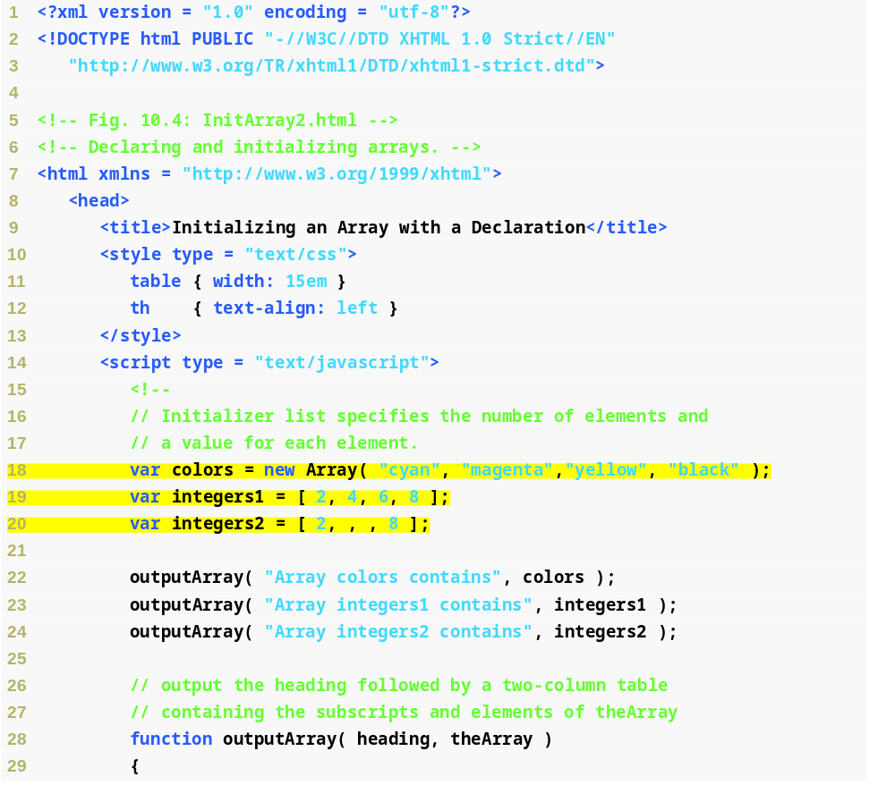
Fig. 10.4 | Declaring and initializing arrays (Part 1 of 3).
Creates an array with four elements, all of which are defined
Creates an array with four elements, all of which are defined in an initializer list
Creates an array with four elements, two of which reserve space for values to be specified later

Slide 20
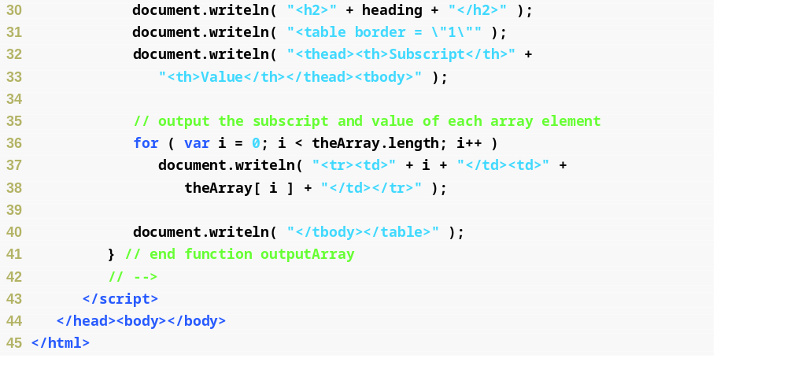
Fig. 10.4 | Declaring and initializing arrays (Part 2 of 3).

Slide 21
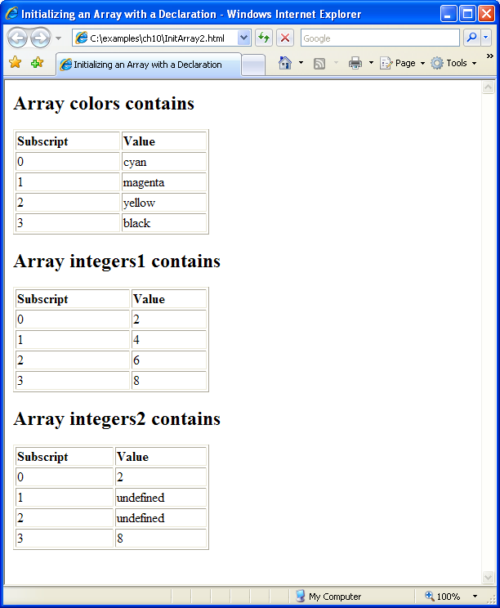
Fig. 10.4 | Declaring and initializing arrays (Part 3 of 3).

Slide 22
10.4 Examples Using Arrays (Cont.)
for…in statement
  Enables a script to perform a task for each element in an array
  Process is known as iterating over the elements of an array

Slide 23
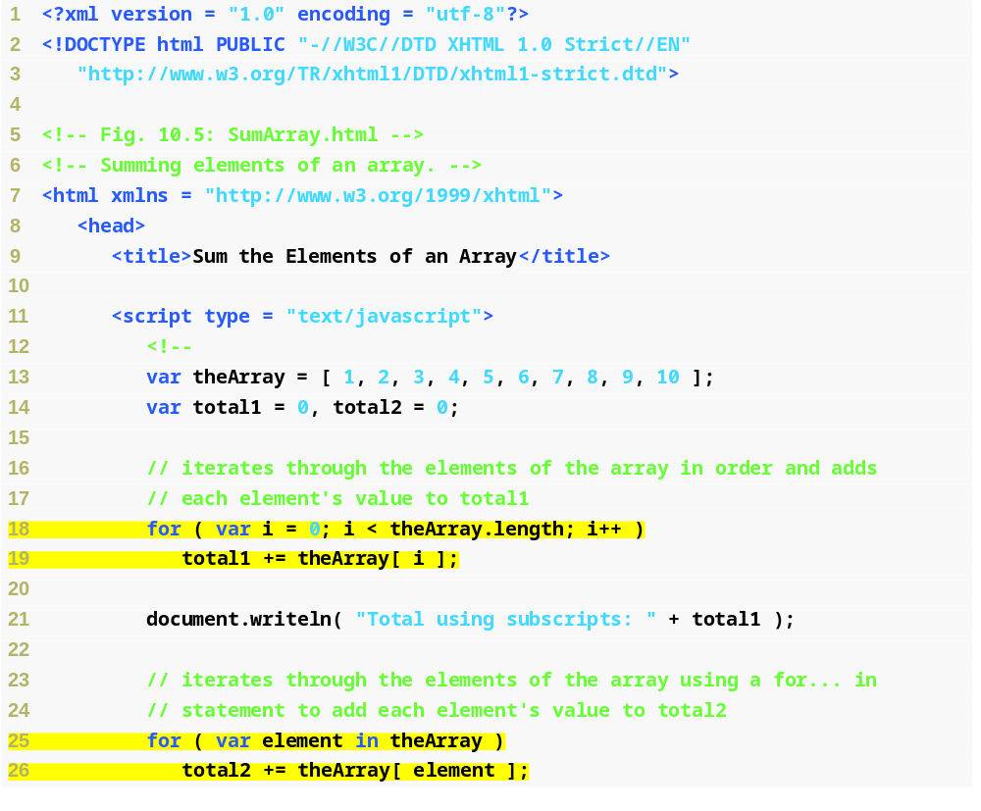
Fig. 10.5 | Summing elements of an array (Part 1 of 2).
Sums the values of all the elements in theArray by iterating through the elements in order
Sums the values of all the elements in theArray by having JavaScript automatically iterate over its elements

Slide 24
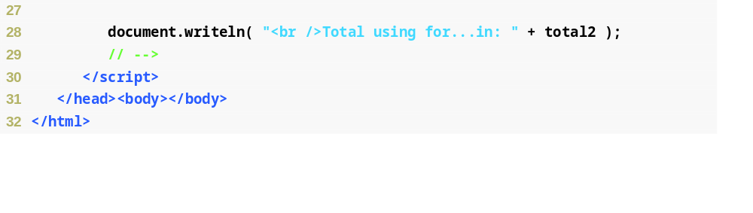
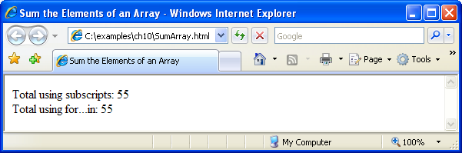
Fig. 10.5 | Summing elements of an array (Part 2 of 2).

Slide 25
Error-Prevention Tip 10.2
When iterating over all the elements of an Array, use a for…in statement to ensure that you manipulate only the existing elements of the Array. Note that a for…in statement skips any undefined elements in the array.

Slide 26
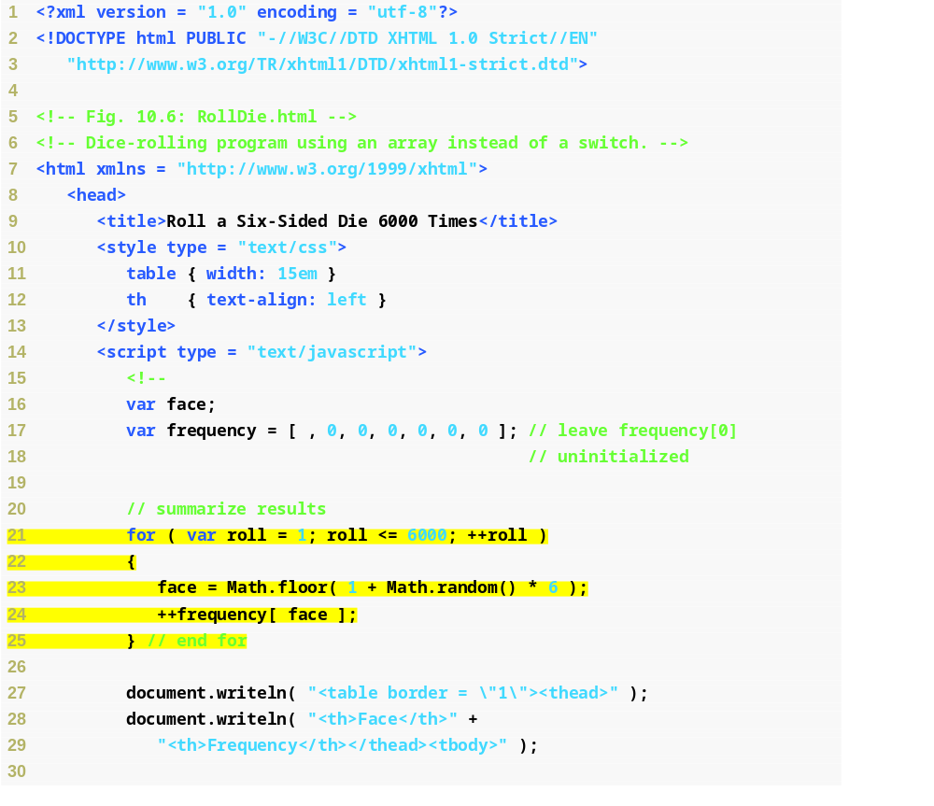
Fig. 10.6 | Dice-rolling program using an array instead of a switch (Part 1 of 2).
Creates a frequency array with each element’s index corresponding to a face value (we leave index 0 uninitialized because the lowest face value is 1)
Randomly picks a face of the die and increments the value of the element with the corresponding index in the frequency array

Slide 27
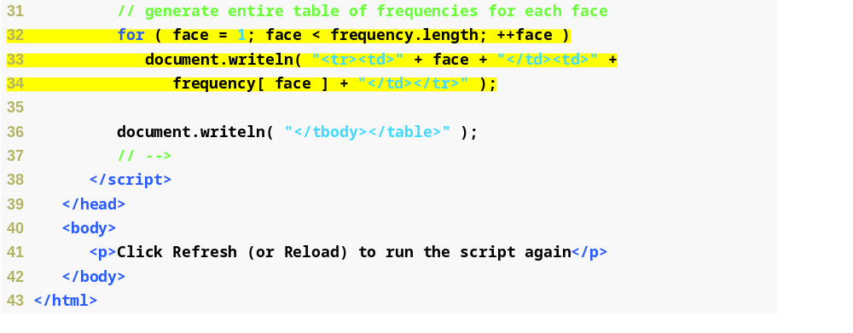
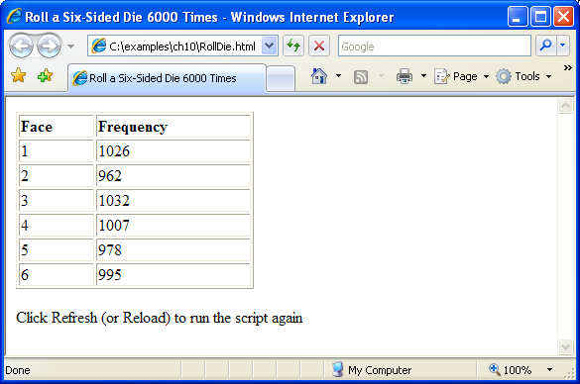
Fig. 10.6 | Dice-rolling program using an array instead of a switch (Part 2 of 2).
Outputs results in a table

Slide 28
10.5 Random Image Generator Using Arrays
Random image generator
  Uses a pictures array to store the names of the image files as strings
  Accesses the array using a randomized index

Slide 29
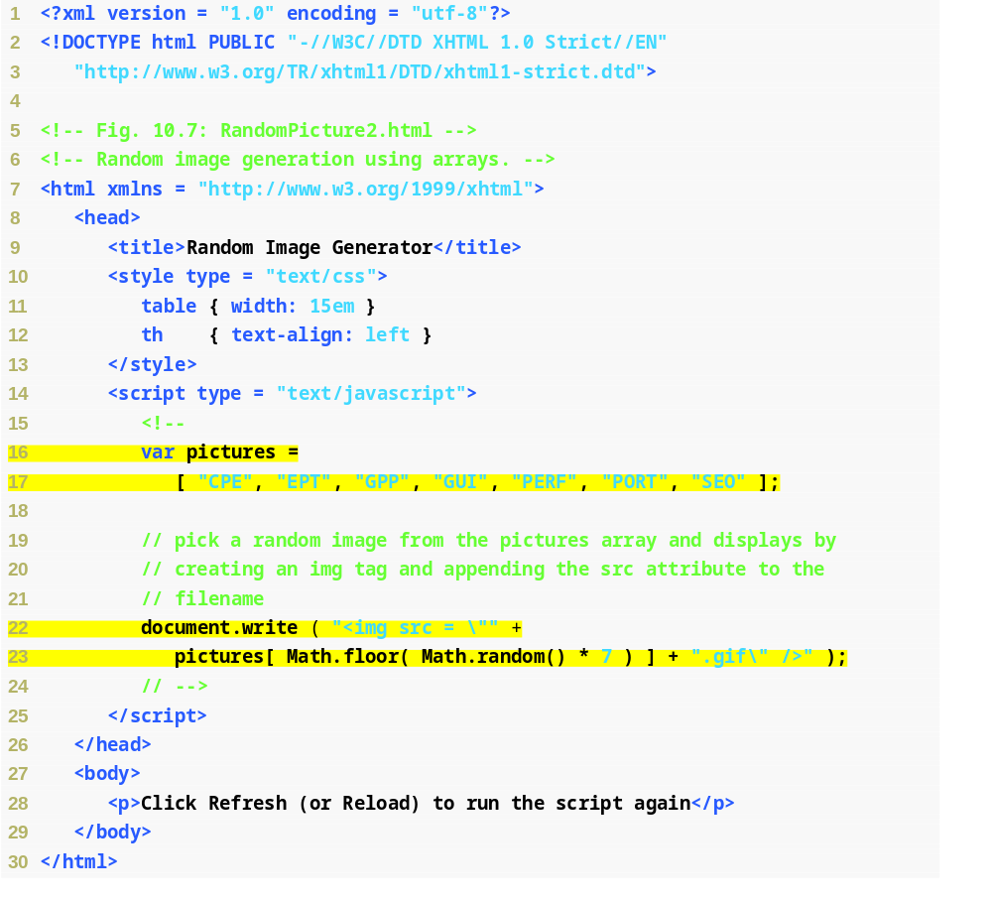
Fig. 10.7 | Random image generation using arrays (Part 1 of 2).
Creates an array with the names of the images to choose from
Randomly selects an element from the array and appends its value to “.gif\” to create the src attribute’s value

Slide 30
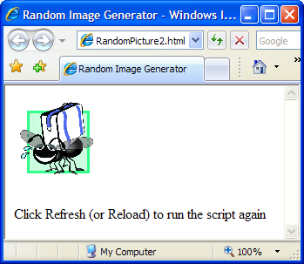
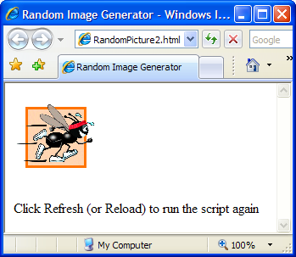
Fig. 10.7 | Random image generation using arrays (Part 2 of 2).

Slide 31
10.6 References and Reference Parameters
Two ways to pass arguments to functions (or methods)
  pass-by-value
  pass-by-reference
Pass-by-value
  a copy of the argument’s value is made and is passed to the called function
In JavaScript, numbers, boolean values and strings are passed to functions by value.
Pass-by-reference
  The caller gives the called function direct access to the caller’s data and allows it to modify the data if it so chooses
  Can improve performance because it can eliminate the overhead of copying large amounts of data, but it can weaken security because the called function can access the caller’s data

Slide 32
10.6 References and Reference Parameters (Cont.)
All objects are passed to functions by reference
Arrays are objects in JavaScript, so Arrays are passed to a function by reference
  a called function can access the elements of the caller’s original Arrays.
Name of an array
  actually a reference to an object that contains the array elements and the length variable

Slide 33
Error-Prevention Tip 10.3
With pass-by-value, changes to the copy of the called function do not affect the original variable’s value in the calling function. This prevents the accidental side effects that so greatly hinder the development of correct and reliable software systems.

Slide 34
Software Engineering Observation 10.2
Unlike some other languages, JavaScript does not allow the programmer to choose whether to pass each argument by value or by reference. Numbers, boolean values and strings are passed by value. Objects are passed to functions by reference. When a function receives a reference to an object, the function can manipulate the object directly.

Slide 35
Software Engineering Observation 10.3
When returning information from a function via a return statement, numbers and boolean values are always returned by value (i.e., a copy is returned), and objects are always returned by reference (i.e., a reference to the object is returned). Note that, in the pass-by-reference case, it is not necessary to return the new value, since the object is already modified.

Slide 36
10.7 Passing Arrays to Functions
Pass an array as an argument to a function
  Specify the name of the array (a reference to the array) without brackets
Although entire arrays are passed by reference, individual numeric and boolean array elements are passed by value exactly as simple numeric and boolean variables are passed
  Such simple single pieces of data are called scalars, or scalar quantities
  To pass an array element to a function, use the subscripted name of the element as an argument in the function call
join method of an Array
  Returns a string that contains all of the elements of an array, separated by the string supplied in the function’s argument
  If an argument is not specified, the empty string is used as the separator

Slide 37
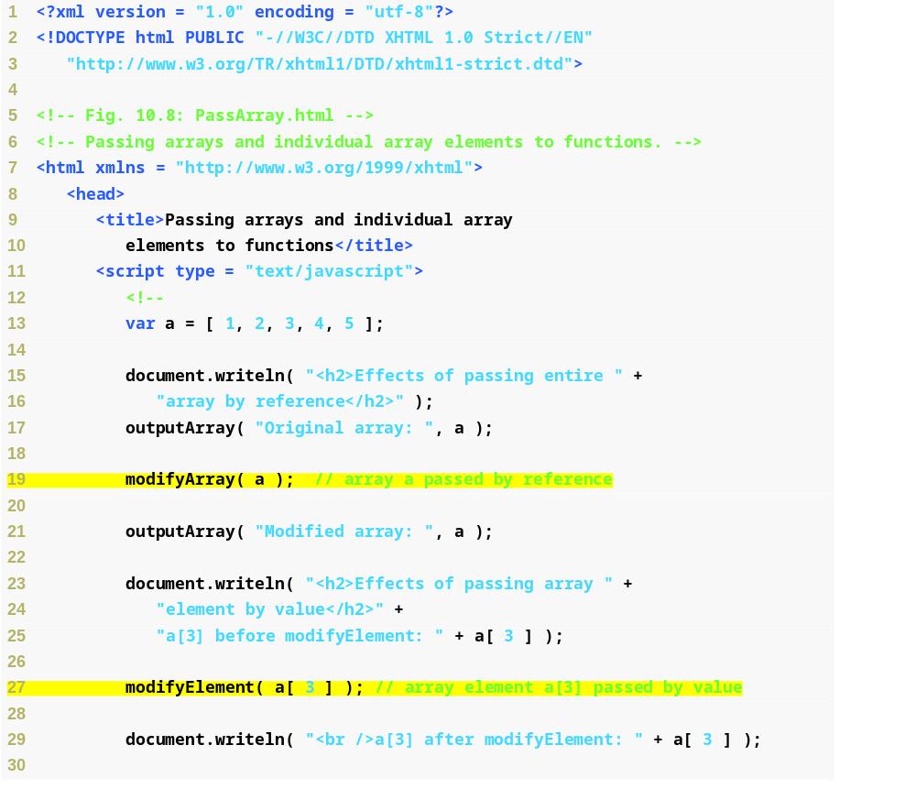
Fig. 10.8 | Passing arrays and individual array elements to functions (Part 1 of 3).
Passes array a to function modifyArray by reference
Passes array element a[3] to function modifyElement by value

Slide 38
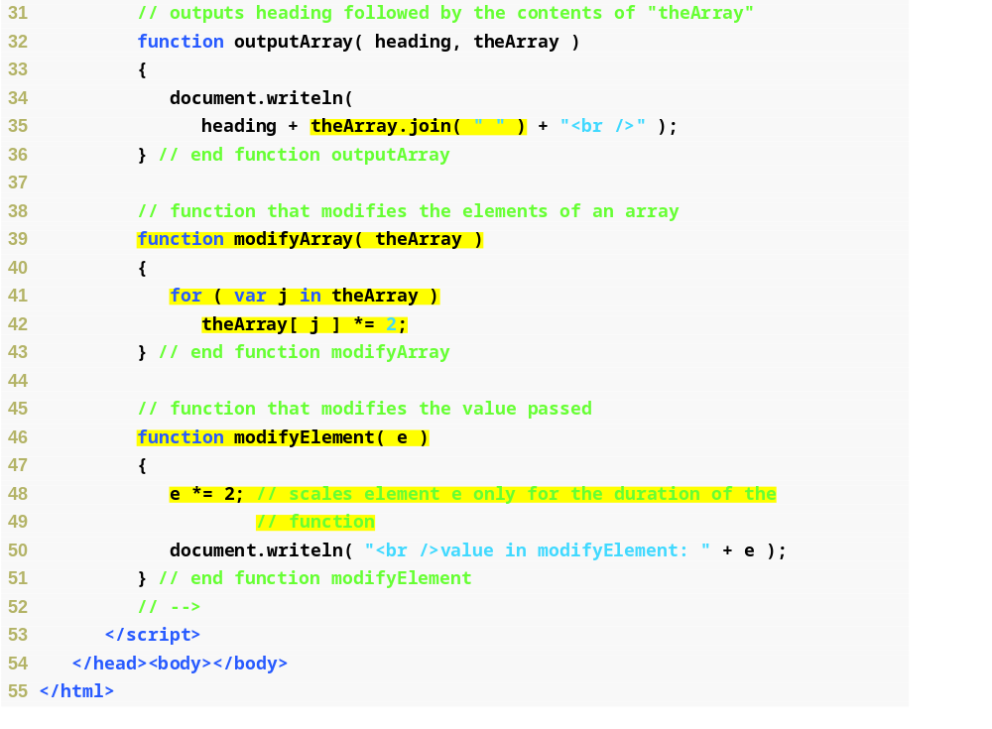
Fig. 10.8 | Passing arrays and individual array elements to functions (Part 2 of 3).
Creates a string containing all the elements in theArray, separated by “ ”
Multiplies each element in theArray by 2, which persists after the function has finished
Multiplies the array element by 2, but only for the duration of the function

Slide 39
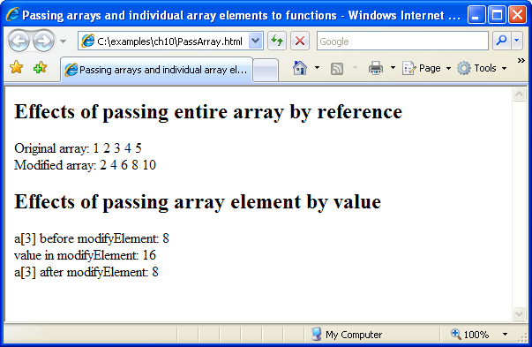
Fig. 10.8 | Passing arrays and individual array elements to functions (Part 3 of 3).

Slide 40
Software Engineering Observation 10.4
JavaScript does not check the number of arguments or types of arguments that are passed to a function. It is possible to pass any number of values to a function. JavaScript will attempt to perform conversions when the values are used.

Slide 41
10.8 Sorting Arrays
Sorting data
  Putting data in a particular order, such as ascending or descending
  One of the most important computing functions
Array object in JavaScript has a built-in method sort
  With no arguments, the method uses string comparisons to determine the sorting order of the Array elements
  Method sort takes as its optional argument the name of a function (called the comparator function) that compares its two arguments and returns a negative value, zero, or a positive value, if the first argument is less than, equal to, or greater than the second, respectively
Functions in JavaScript are considered to be data
  They can be assigned to variables, stored in Arrays and passed to functions just like other data

Slide 42
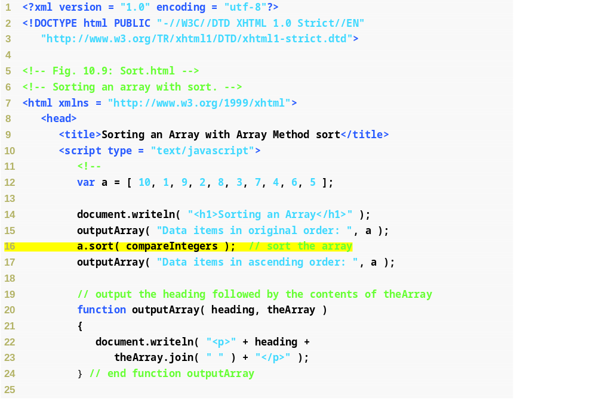
Fig. 10.9 | Sorting an array with sort (Part 1 of 2).
Passes function compareIntegers to method a.sort to arrange the elements of a in ascending numerical order

Slide 43
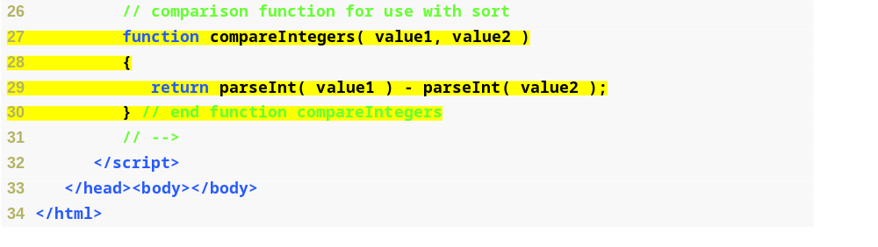
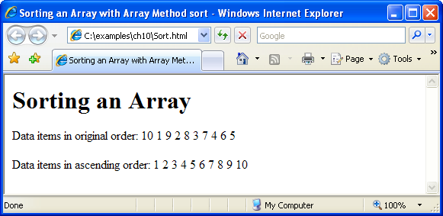
Fig. 10.9 | Sorting an array with sort (Part 2 of 2).
Defines a function comparing integers to be passed to method sort (to replace the default string comparison function)

Slide 44
Software Engineering Observation 10.5
Functions in JavaScript are considered to be data. Therefore, functions can be assigned to variables, stored in Arrays and passed to functions just like other data types.

Slide 45
10.9 Searching Arrays: Linear Search and Binary Search
Linear search algorithm
  Iterates through the elements of an array until it finds an element that matches a search key, and returns the subscript of the element
  If the key is not found, the function returns -1
  If the array being searched is not in any particular order, it is just as likely that the value will be found in the first element as the last
  On average, the program will have to compare the search key with half the elements of the array

Slide 46
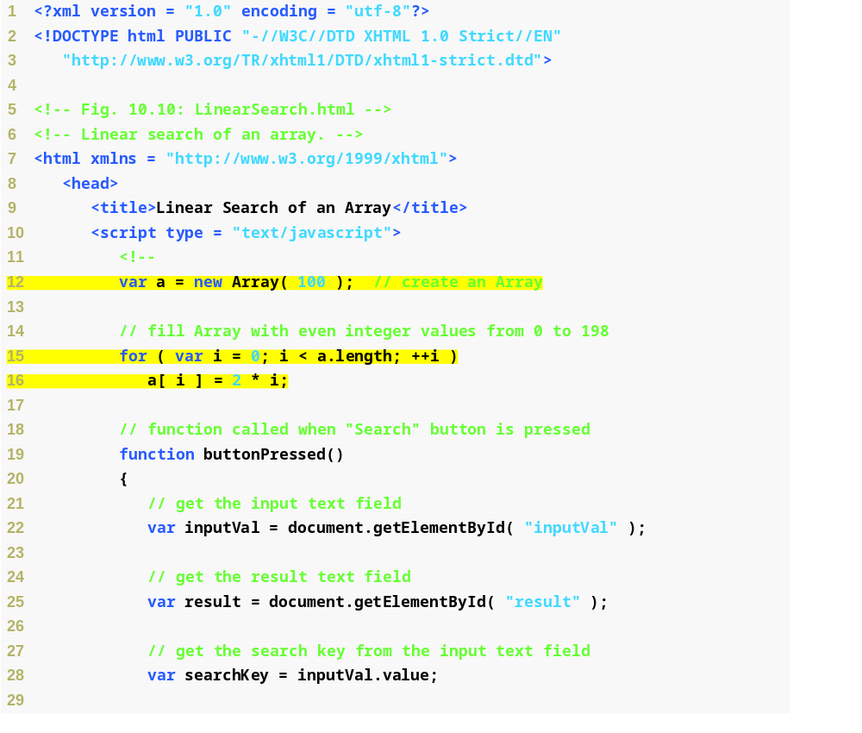
Fig. 10.10 | Linear search of an array (Part 1 of 3).
Creates a new array to search
Initializes each array element with a value double its index

Slide 47
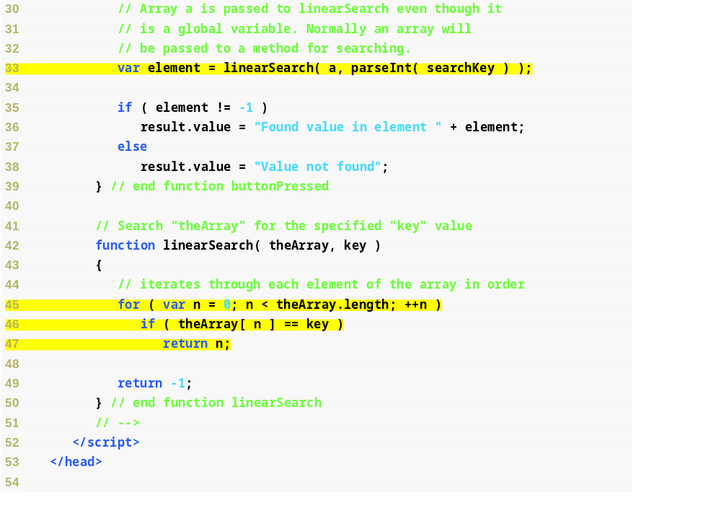
Fig. 10.10 | Linear search of an array (Part 2 of 3).
Calls function linearSearch on array a with the value input by the user
Iterates through every element of the array until the key is found
If the key is encountered, the index of the element with the key as its value is returned
If the key is not found, -1 is returned

Slide 48
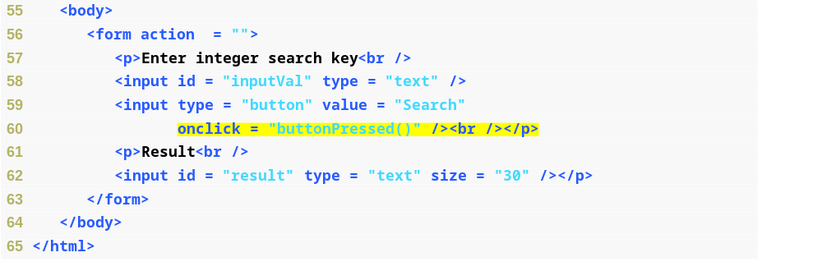
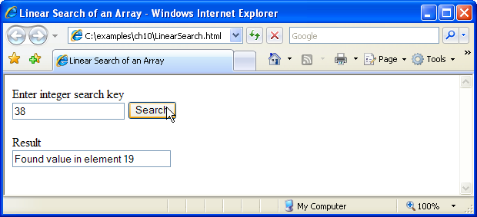
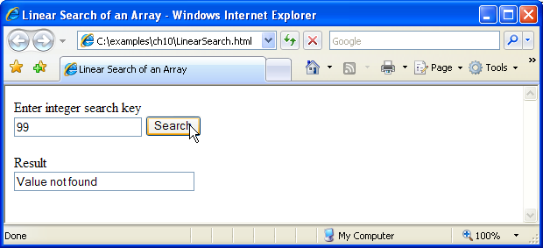
Fig. 10.10 | Linear search of an array (Part 3 of 3).
When the Search button is pressed, calls function buttonPressed

Slide 49
10.9 Searching Arrays: Linear Search and Binary Search (Cont.)
Binary search algorithm
  More efficient than the linear search algorithm
  Requires that the array be sorted
  Tests the middle element in the array and returns the index if it matches the search key
  If not, it cuts the list in half, depending on whether the key is greater than or less than the middle element, and repeats the process on the remaining half of the sorted list
  The algorithm ends by either finding an element that matches the search key or reducing the subarray to zero size
Tremendous increase in performance over the linear search
  For a one-billion-element array, this is the difference between an average of 500 million comparisons and a maximum of 30 comparisons
The maximum number of comparisons needed for the binary search of any sorted array is the exponent of the first power of 2 greater than the number of elements in the array

Slide 50
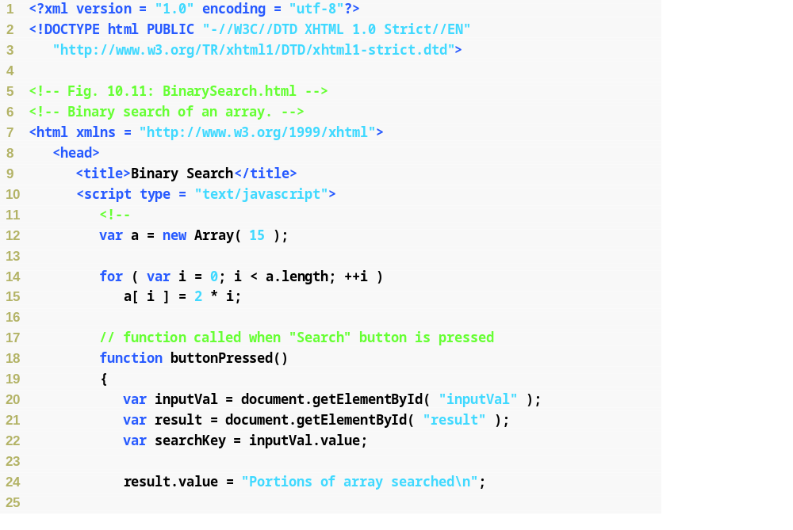
Fig. 10.11 | Binary search of an array (Part 1 of 5).

Slide 51
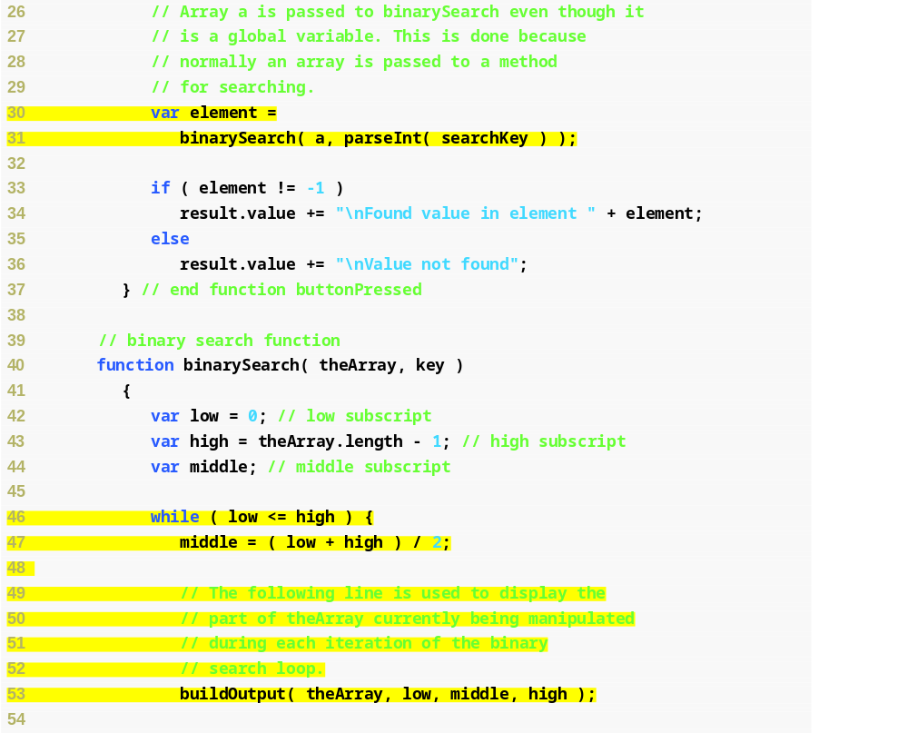
Fig. 10.11 | Binary search of an array (Part 2 of 5).
Calls function binarySearch with arguments a and the key specified by the user
While the search has not checked all values, find the midpoint of the unchecked region
Displays the portion of the array currently being examined

Slide 52
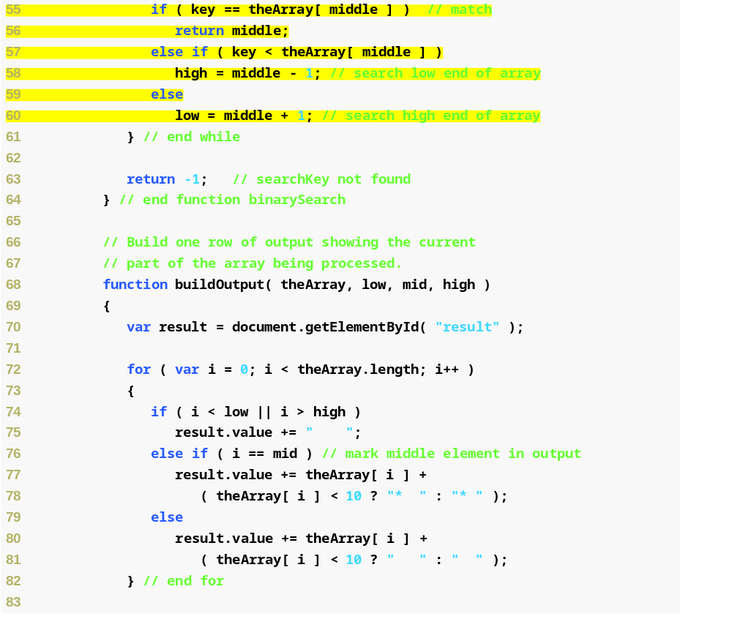
Fig. 10.11 | Binary search of an array (Part 3 of 5).
If the middle element’s value is the key, return its subscript
Otherwise, if the middle element’s value is higher than the key, we only need to search the bottom half of the array
Otherwise, if the middle element’s value is lower than the key, we only need to search the higher half of the array
If we’ve covered the whole array without encountering the key, return -1

Slide 53
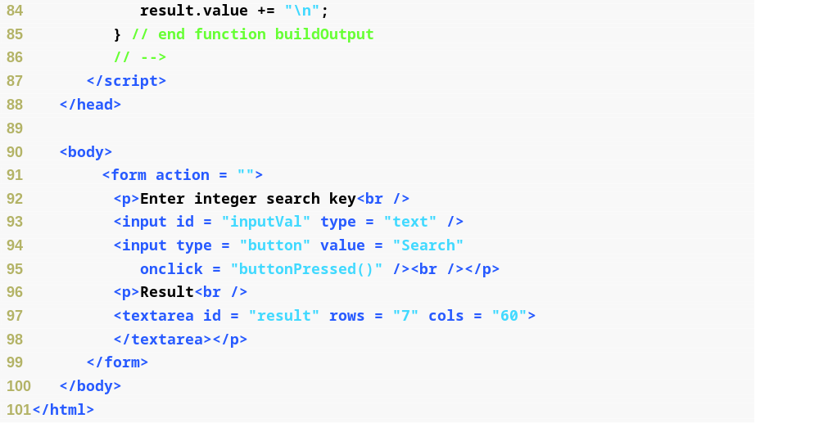
Fig. 10.11 | Binary search of an array (Part 4 of 5).

Slide 54
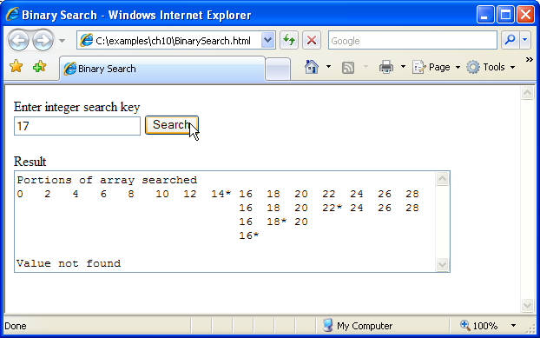
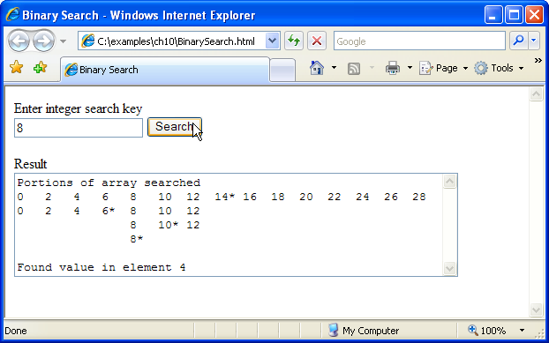
Fig. 10.11 | Binary search of an array (Part 5 of 5).

Slide 55
10.10 Multidimensional Arrays
To identify a particular two-dimensional multidimensional array element
  Specify the two subscripts
  By convention, the first identifies the element’s row, and the second identifies the element’s column
In general, an array with m rows and n columns is called an m-by-n array
Two-dimensional array element accessed using an element name of the form a[ i ][ j ]
  a is the name of the array
  i and j are the subscripts that uniquely identify the row and column
Multidimensional arrays are maintained as arrays of arrays

Slide 56
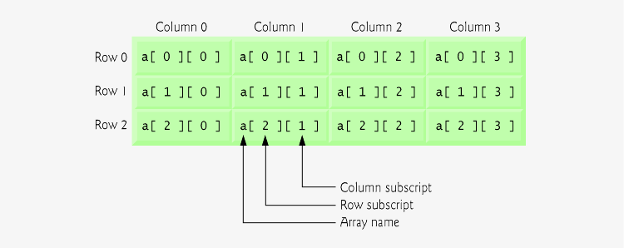
Fig. 10.12 | Two-dimensional array with three rows and four columns.

Slide 57
10.10 Multidimensional Arrays (Cont.)
Multidimensional arrays can be initialized in declarations like a one-dimensional array, with values grouped by row in square brackets
  The interpreter determines the number of rows by counting the number of sub initializer
  The interpreter determines the number of columns in each row by counting the number of values in the sub-array that initializes the row
The rows of a two-dimensional array can vary in length
A multidimensional array in which each row has a different number of columns can be allocated dynamically with operator new

Slide 58
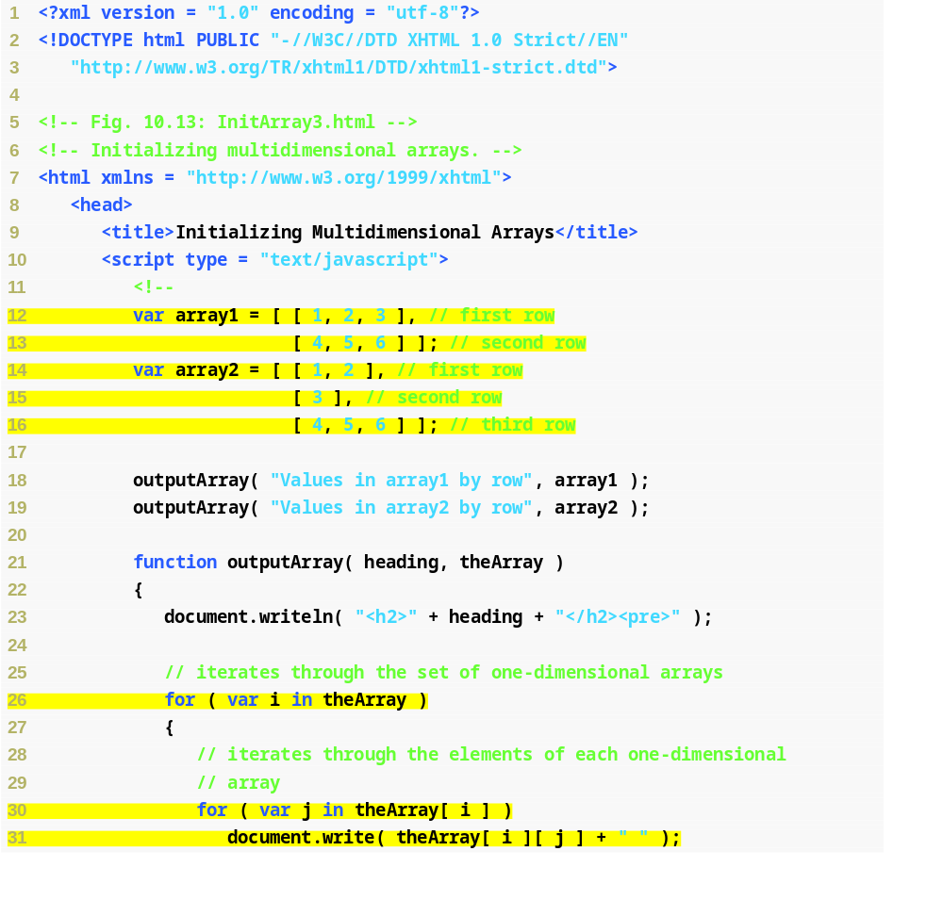
Fig. 10.13 | Initializing multidimensional arrays (Part 1 of 2).
Initializes array1 with an initializer list of sub initializer lists
Initializes array2 with rows of different lengths
Nested for…in statements traverse the arrays by iterating through the sets of one-dimensional arrays, then through the elements of each of those one-dimensional arrays

Slide 59
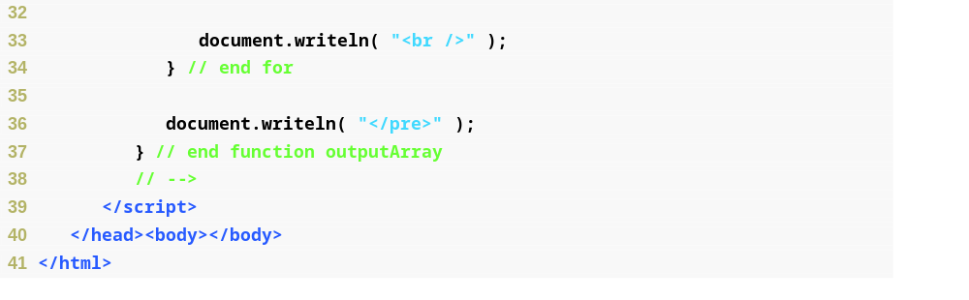
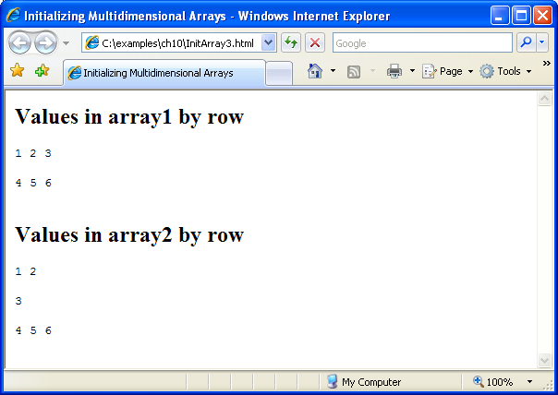
Fig. 10.13 | Initializing multidimensional arrays (Part 2 of 2).

